Slide 1
International Conference
Equal Care and Equal Pay – It is high time to close the gaps!
7 September 2022
The gender pay gap: trends, causes and policy responses
Valentina Patrini
OECD – Social Policy Analyst

Slide 2
The gender pay gap: a key issue for gender equality
Note: The 2021 Gender Equality Questionnaire asked Adherents to select the priority issues in gender equality in their country from a list of topics. Number of responses: 41, of which 1 did not identify priority 3, and 1 identified two items as priority 3.
Source: 2021 Gender Equality Questionnaire, referred to in OECD (2022), Report on the implementation of the OECD gender recommendations, https://www.oecd.org/mcm/Implementation-OECD-Gender-Recommendations.pdf
Notes:
The OECD has recently conducted an assessment of the implementation of its Recommendations on Gender Equality. We consulted Adherents on various issues related to gender equality.
It comes with no surprise that, after violence against women, countries identified the gender pay gap as the second most urgent priority for gender equality. The unequal division of household tasks is also among the key issues.
Some good news is that women have made significant gains in labour force participation and career advancement over the past few decades. Progress was threatened by the COVID-19 pandemic, but after important employment losses, women’s employment almost reached pre-pandemic levels in Q3 of 2021. Yet, evidence from EU countries shows that women experienced a sharper fall in working hours.

Slide 3
The OECD average gender wage gap has decreased over the last 25 years
Gender wage gap (%) for full-time dependent employees at the median
Note: Values represent for full-time workers at the median the difference between the earnings of men and of women relative to the earnings of men. OECD average presents the unweighted average of the latest data across all OECD countries.
Source: OECD (2022), Gender wage gap indicator https://data.oecd.org/earnwage/gender-wage-gap.htm
Notes:
Another good news is that over the last 25 years, the gender wage gap has been narrowing, albeit slowly, over time - from 19% to 11.7% on average across the OECD.
The bad news is that this is still a very serious gender equality challenge. A wage gap of 11.7% means that a woman working full-time today makes 88 cents, on average, for every euro a full-time working man makes at median earnings – see in yellow in the next slide.

Slide 4
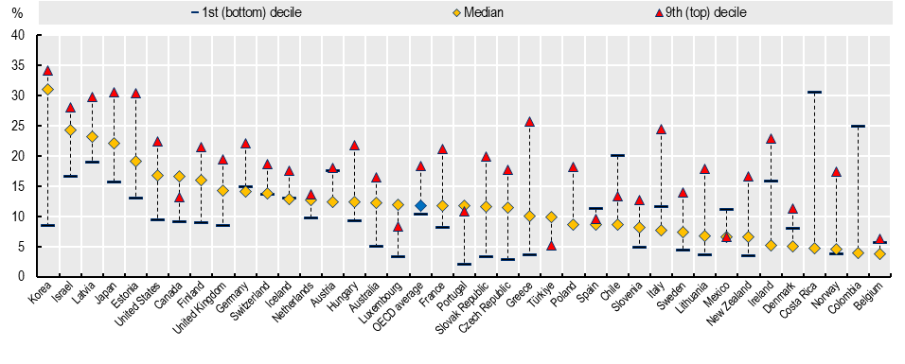
Women make about 88 cents for every man’s euro, on average, across OECD countries
Gender wage gap (%) for full-time dependent employees at median, bottom 10% and top 10% of earnings
Note: Values represent for full-time workers at the median the difference between the earnings of men and of women relative to the earnings of men, 2021 or more recent year. OECD average presents the unweighted average of the latest data across all OECD countries.
Source: OECD (2022), Gender wage gap indicator https://data.oecd.org/earnwage/gender-wage-gap.htm
Notes:
In several countries, such as Korea, Israel, Latvia and Japan, the gender wage gap is over 20%.
These aggregate gender pay gaps likely underestimate the extent of the gender pay gap across different groups, as there are intersecting forms of discrimination based on different background factors like race/ethnicity, gender identity and sexual orientation.
The gap gets even larger when looking at the average pay all working women and men take home at the end of the year, as women tend to spend fewer hours in paid work than men do. Women are overrepresented in part-time jobs, and underrepresented in jobs with long work hours.
We also see that that gender pay gaps are often smaller among low-earners – also thanks to the presence of minimum wage regulations.
In turn, they are widest among top earners – reflecting the difficulty for women to advance in labour markets, maybe also due to their weaker bargaining position compared to men.
Adequate earnings are crucial for ensuring women’s economic independence throughout life, of course, but the consequences of low pay are painfully obvious in old age.
Indeed, women’s retirement income is only around three-quarters of the retirement income of men on average in the OECD, which contributes to higher poverty rates for women.

Slide 5
What causes the gender pay gap?
Horizontal segregation
Vertical segregation
Gender stereotypes and discrimination
Unequal sharing of unpaid work hours, motherhood penalty
More insights from OECD research using matched employer-employee data
Notes:
Before we can consider policy strategies to address the gender wage gap, we obviously need to think its causes. This can quickly become a very long list.
One driver is horizontal segregation, meaning that men and women are concentrated in specific sectors or jobs. Women tend to be overrepresented in fields that pay relatively lower wages, such as caregiving and service sector jobs, and underrepresented in fields with relatively higher wages, such as science and technology jobs.
Another is vertical segregation: women face challenges in career advancement and are underrepresented in management roles, which tend to pay better.
These forms of segregation also relate to gender stereotypes and their impact on career choices and expectations, as well as discrimination in hiring practices.
Much of the above is also related to the unequal sharing of unpaid work hours and the motherhood penalty.
At the OECD, we’ve got a better understanding of the above by conducting a study research using matched employer-employee data across a sample of 16 OECD countries. This allowed to get more insights by analysing differences in pay policies for similarly-qualified women and men within and between firms.

Slide 6
Differences in pay policies between firms account for about 1/4 of the gender wage gap
Decomposition of gender wage gap between similarly-qualified women and men within and between firms
Note: The wage gap between similarly skilled women and men is obtained from a regression of log wages on a gender dummy and flexible earnings-experience profiles as well as education (education is not available for Austria and Estonia) and decade-of-birth dummies to control for cohort effects.
Source: OECD (2021), The Role of Firms in Wage Inequality: Policy Lessons from a Large Scale Cross-Country Study, OECD Publishing, Paris, https://dx.doi.org/10.1787/7d9b2208-en
Notes:
We found that:
1/4 of the gender wage gap is explained by differences in pay between firms due to higher employment shares of women in low-wage firms – which may be the result of:
discriminatory hiring practices by employers-
women’s preferences for firms with flexible working-time arrangements – which in turn tend to offer lower wages
About 3/4 of the wage gap between similarly-qualified women and men is attributable to differences within firms. This is mainly due to differences in tasks and responsibilities but also, to a lesser extent, to differences in pay for work of equal value (for instance as a result of bargaining or discrimination).

Slide 7
The gender wage gap increases over the life course, particularly after having children
Within firms: differences in the incidence of promotions.
Between firms: differences in the nature of job mobility.
Career breaks around the age of childbirth account for a large fraction of the “motherhood penalty”
Much of all this can be attributed to the unequal sharing of unpaid work hours between parents.
Wage loss following a career break by skill (wage tercile)
Note: Sample: Women aged 25 to 34 (different reference periods across countries).
Source: OECD (2021), The Role of Firms in Wage Inequality: Policy Lessons from a Large Scale Cross-Country Study https://dx.doi.org/10.1787/7d9b2208-en
Notes:
The gender wage gap within and between firms tends to increase over the life course, particularly after having children. Over time:
Within firms: Women are less likely to be promoted in part because they are more likely to work in part-time jobs and to have career breaks.
Between firms: women change jobs less often for wage and career considerations and more often for personal reasons (e.g. having more flexible working-time arrangements, working closely from home, following a partner).
Career breaks around the age of childbirth account for a large fraction of the “motherhood penalty”, i.e. the shortfall in wage or earnings growth following childbirth. These in turn play an important role in determining the evolution of the gender wage and earnings gaps over the working life.
The unequal sharing of unpaid work hours between parents plays a key role in all we have discussed so far. Even before the pandemic, in every country in the world women were doing more unpaid care work than men. This limits both the time women can spend in paid work and their possibilities to advance to a higher-paying position.
So we went into the pandemic with this longstanding inequality in unpaid caregiving.
At the OECD we ran the Risks that Matter survey, and found that during the pandemic mothers were nearly three times as likely as fathers to report that they took on most or all of additional unpaid care work related to school or childcare closures.

Slide 8
Policy implications: A comprehensive approach is needed
Education: access, attainment and choices
Family policies:
Parental leave policies
Early childhood and education
Financial incentives
Labour market policies and policies targeted at firms:
Equal pay laws and anti-discrimination laws
Wage-setting institutions
Pay transparency measures
Quotas, voluntary target-setting and soft measures to break the glass ceiling
Notes:
Governments have implemented a range of policies, over decades, to address the many factors driving the gender wage gap. But we still have not yet achieved pay equity. We need a life-course, comprehensive approach to achieve gender equality – in education, in paid and unpaid work, and in society as a whole.
Closing gender gaps in access to education, educational attainment and addressing gender bias in educational choices over time has helped, but not enough and more needs to be done.
As gender wage gap tends increase with age and particularly around the age of motherhood, gender-sensitive family policies are key – including parental leave policies, early childhood and education and the financial incentives supporting dual earners models.
Policy makers have to go further by combing families policies with labour market policies and policies directed at firms.
Equal pay laws and anti-discrimination laws have been crucial for ensuring workers’ rights – but in practice these laws put the onus of equal pay on individual workers to ensure that employers adhere to equal rights law, and they can do little to close gender pay gaps more broadly. They need to be complemented by other interventions.
Strengthening wage-setting institutions in the form of minimum wages and collective bargaining
Pay transparency measures – which very directly target unequal pay. Sharing information about the average wages of men and women within firms, especially when disaggregated by job classification, can support underpaid workers to negotiate up their wage. Many OECD countries are implementing promising new pay transparency tools like
employer pay gap reporting,
equal pay audits, and
job classification systems.
And finally, continue to use quotas, voluntary target-setting and soft measures to help breaking the glass ceiling.

Slide 9
OECD sources and publications on the gender pay gap
OECD (forthcoming, September 2022), The gender wage gap in Germany and the role of firms: new evidence and policy lessons, OECD Publishing, Paris.
OECD Family Database https://www.oecd.org/els/family/database.htm.
OECD (2022), Report on the implementation of the OECD gender recommendations, OECD, https://www.oecd.org/mcm/Implementation-OECD-Gender-Recommendations.pdf.
OECD (2021), Pay Transparency Tools to Close the Gender Wage Gap, OECD Publishing, Paris, https://dx.doi.org/10.1787/eba5b91d-en.
OECD (2021), The Role of Firms in Wage Inequality: Policy Lessons from a Large Scale Cross-Country Study, OECD Publishing, Paris, https://dx.doi.org/10.1787/7d9b2208-en.

Slide 10
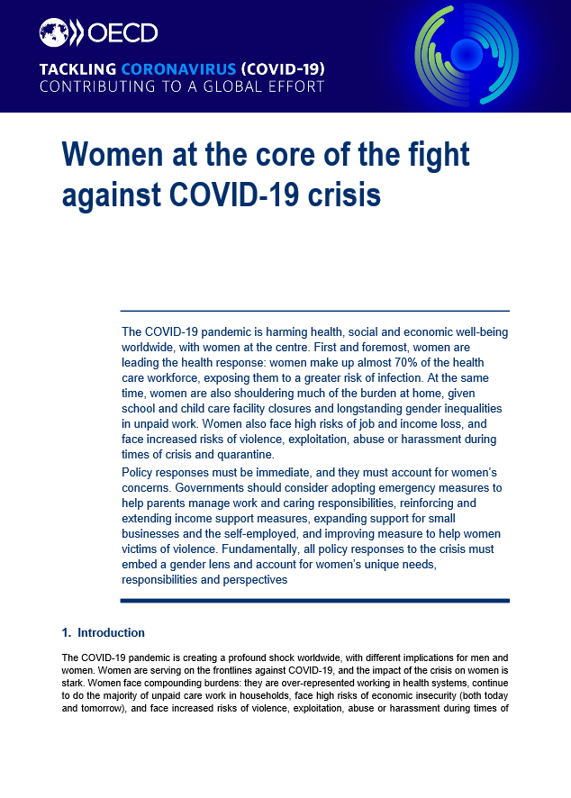
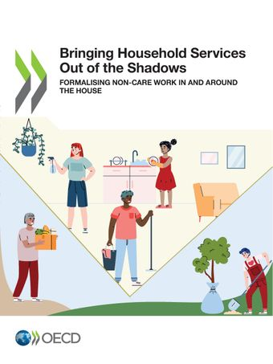
Thank you!
Email me
Valentina.Patrini@oecd.org
Follow us on Twitter
@OECD_Social
Visit our website
http://oe.cd/fdb // http://oe.cd/fdb-fr
http://oe.cd/gender // www.oecd.org/fr/parite

